Slide 1
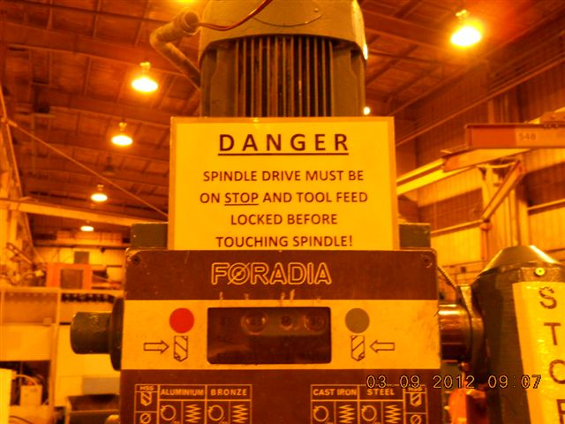
HS&E INCIDENT BULLETIN |  | 2nd Quarter 2012
Type of Incident | Laceration
Summary:
Employee sustained a laceration in palm of hand below thumb while changing a chuck on a drill press. While changing the drill bit the down force on the chuck key caused the spindle to drop and kicked the machine on. The key was still in the chuck and cut the employee's hand when it spun around.
Root Causes: | Actions Taken Thus Far: Next Steps
Incomplete procedure/instructions due to lace of knowledge of the machine Antiquated machine | Researching possible replacement machine for this old drill Revised the JSA to explain how the drill works Installed large, visual labels to instruct the operator on drill characteristics Trained operators on the revised JSA

